Slide 1
MMEdge: Accelerating On-device Multimodal Inference via Pipelined Sensing and Encoding
Runxi Huang, Mingxuan Yu, Mingyu Tsoi, Xiaomin Ouyang
Department of Computer Science and Engineering
Hong Kong University of Science and Technology
ACM/IEEE SenSys 2026

Slide 2
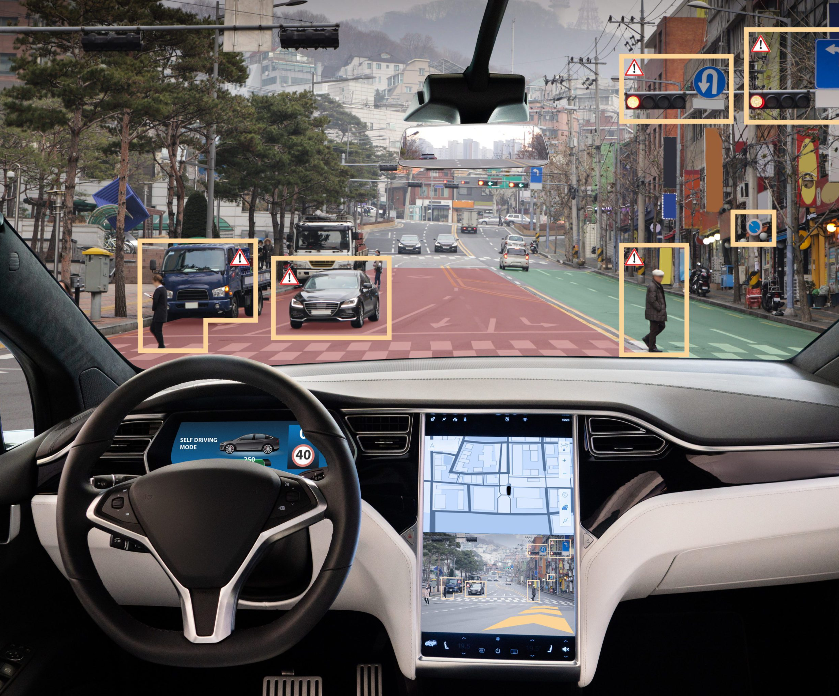
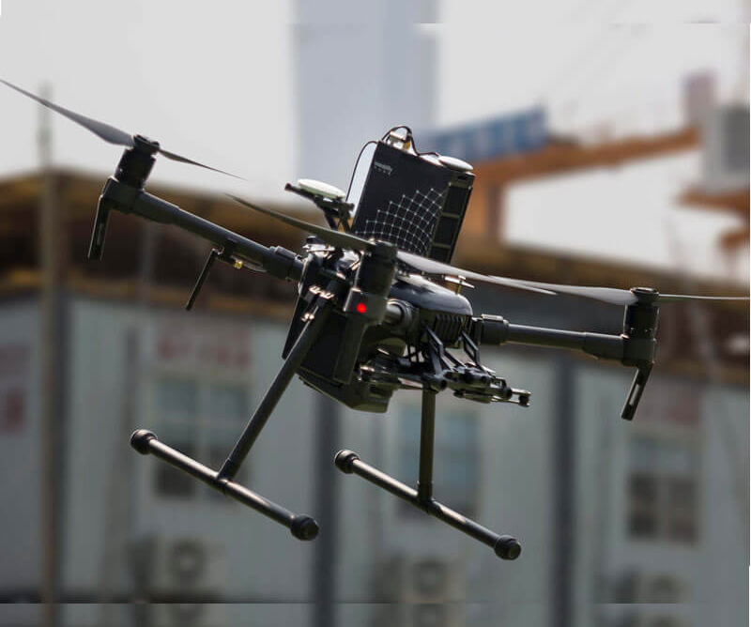

Multimodal Sensing Systems
Applications
Autononous Driving
Unmanned Aerial Vehicle
Mobile GUI Agent
Real-time requirements
Privacy concern and network fluctuation
On-device multimodal system

Slide 3
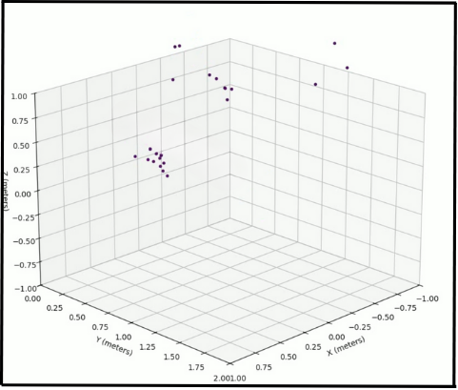

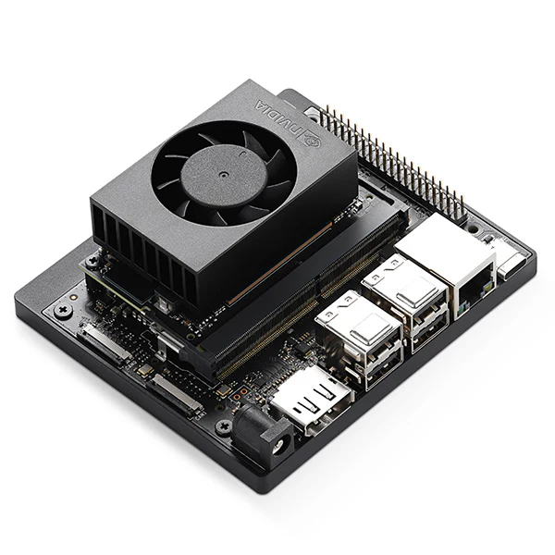
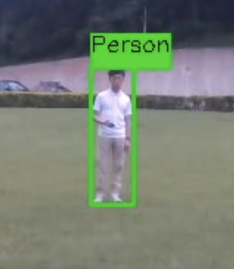


Multimodal Sensing Systems
On-device multimodal inference system
Sensing
Unimodal Encoding
Multimodal Fusion & Prediction
Radar
Radar Encoder
Prediction:
Bounding Box
Camera
Video Encoder
Traditional sequential processing framework incurs large latency:
blocking unimodal encoding until all data arrives

Slide 4
Our key idea is to pipeline sensing and encoding into smaller units
Sensing
Unimodal Encoding
Radar
Radar Encoder
Hide model inference during sensing interval
Camera
Video Encoder

Slide 5






MMEdge: System Overview
The first pipelined sensing and encoding framework for on-device multimodal system
Multimodal
Streaming Data
RGB
Encoder
RGB
Encoder
RGB
Encoder
$$T_{1}$$
$$T_{2}$$
Camera
$$T_{2}$$
$$T_{3}$$
$$T_{1}$$
Sensing Interval: 50ms
Sensing Interval 70ms
$$T_{3}$$
Radar
Encoder
Radar
Encoder
Radar
Encoder
Radar
$$T_{4}$$
Encoding Latency: 60ms
(ResNet-18 -> ResNet-50)
Encoding Latency: 40 ms
Alternating-based Temporal Aggregation
Adaptive Multimodal Configuration

Slide 6
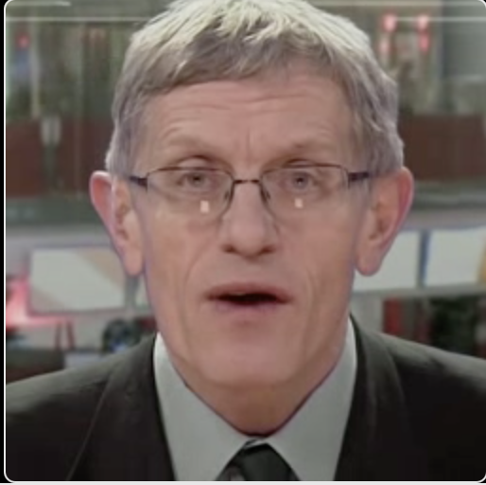



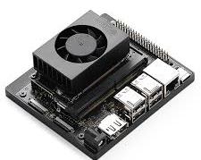
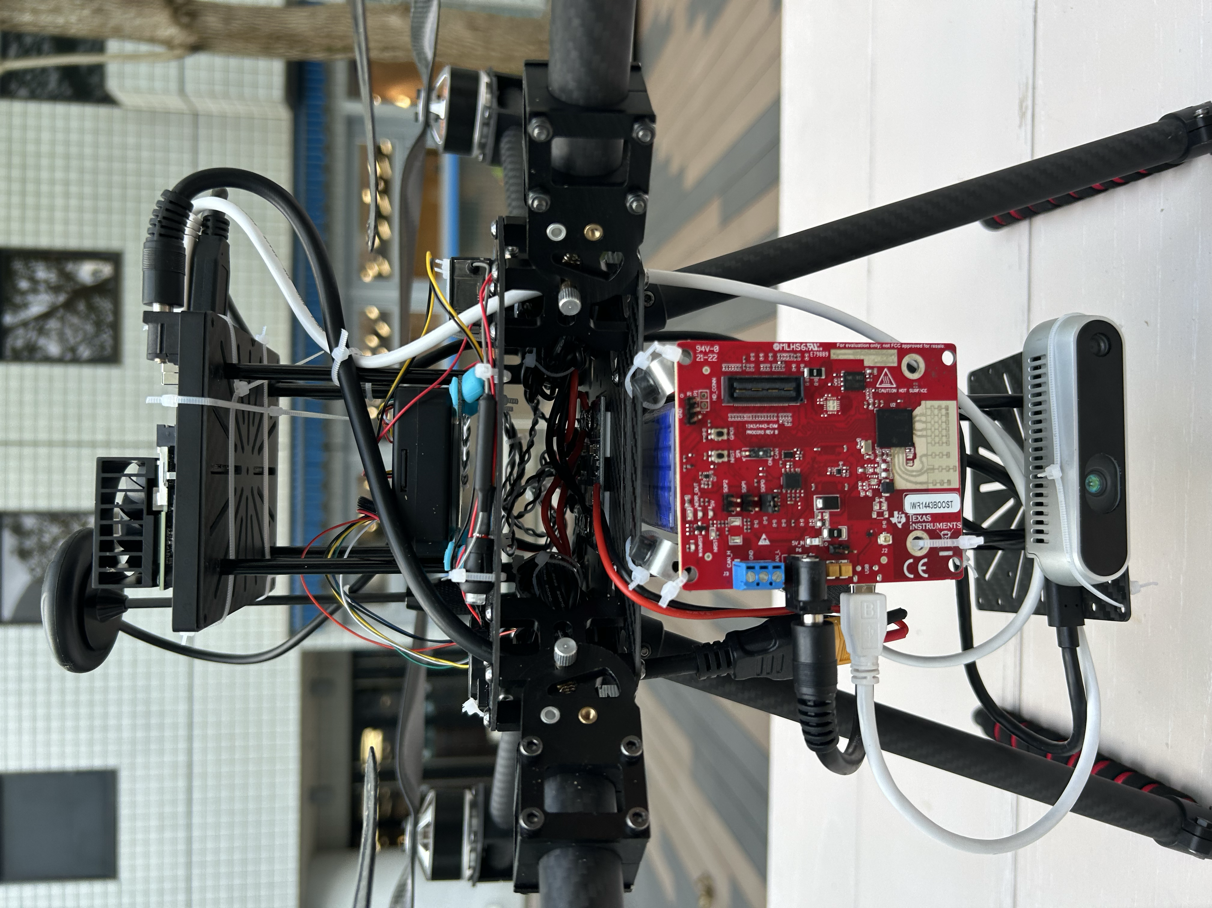
Evaluation: Experiment Setting
Multimodal applications across 5 different modalities
7 SOTA Baselines
  Blocking Inference
  Non-blocking Inference
  Modality Gating (RTSS’23)
  Modality Imputation (MobiSys’21)
  Model Selection
  Pipeline Min
  Pipeline Max
Task | Dataset | Modalities | Models | # Samples
Audio-Visual Speech Recognition | LRW |  | ResNet CNN | 50000
Autonomous Driving VQA | NuScenes-QA-Mini |  | ResNet, OPT-125M LLM | 4458
Real-time Human Tracking | Self-collected UAV |  | YOLO, ResNet | 5687
System implementation on edge devices
NVIDIA Jetson Xavier NX 16GB
UAV Testbed

Slide 7
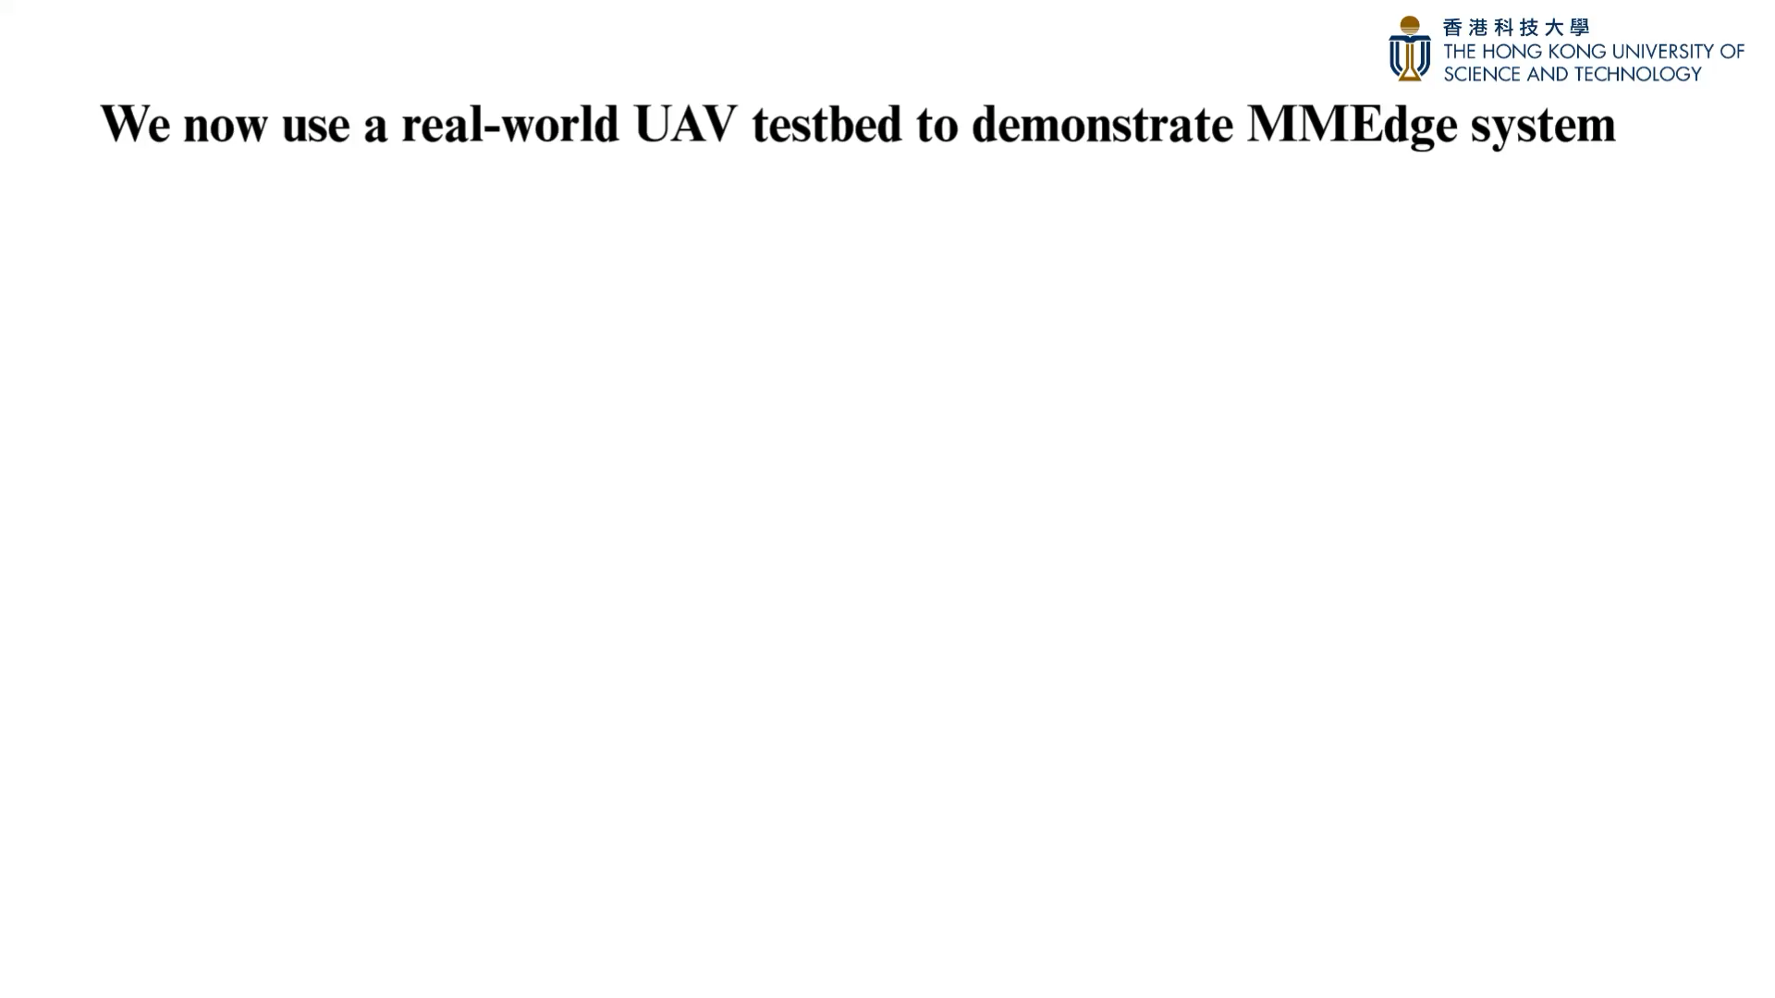
Evaluation: Real-world UAV Case Study

Slide 8
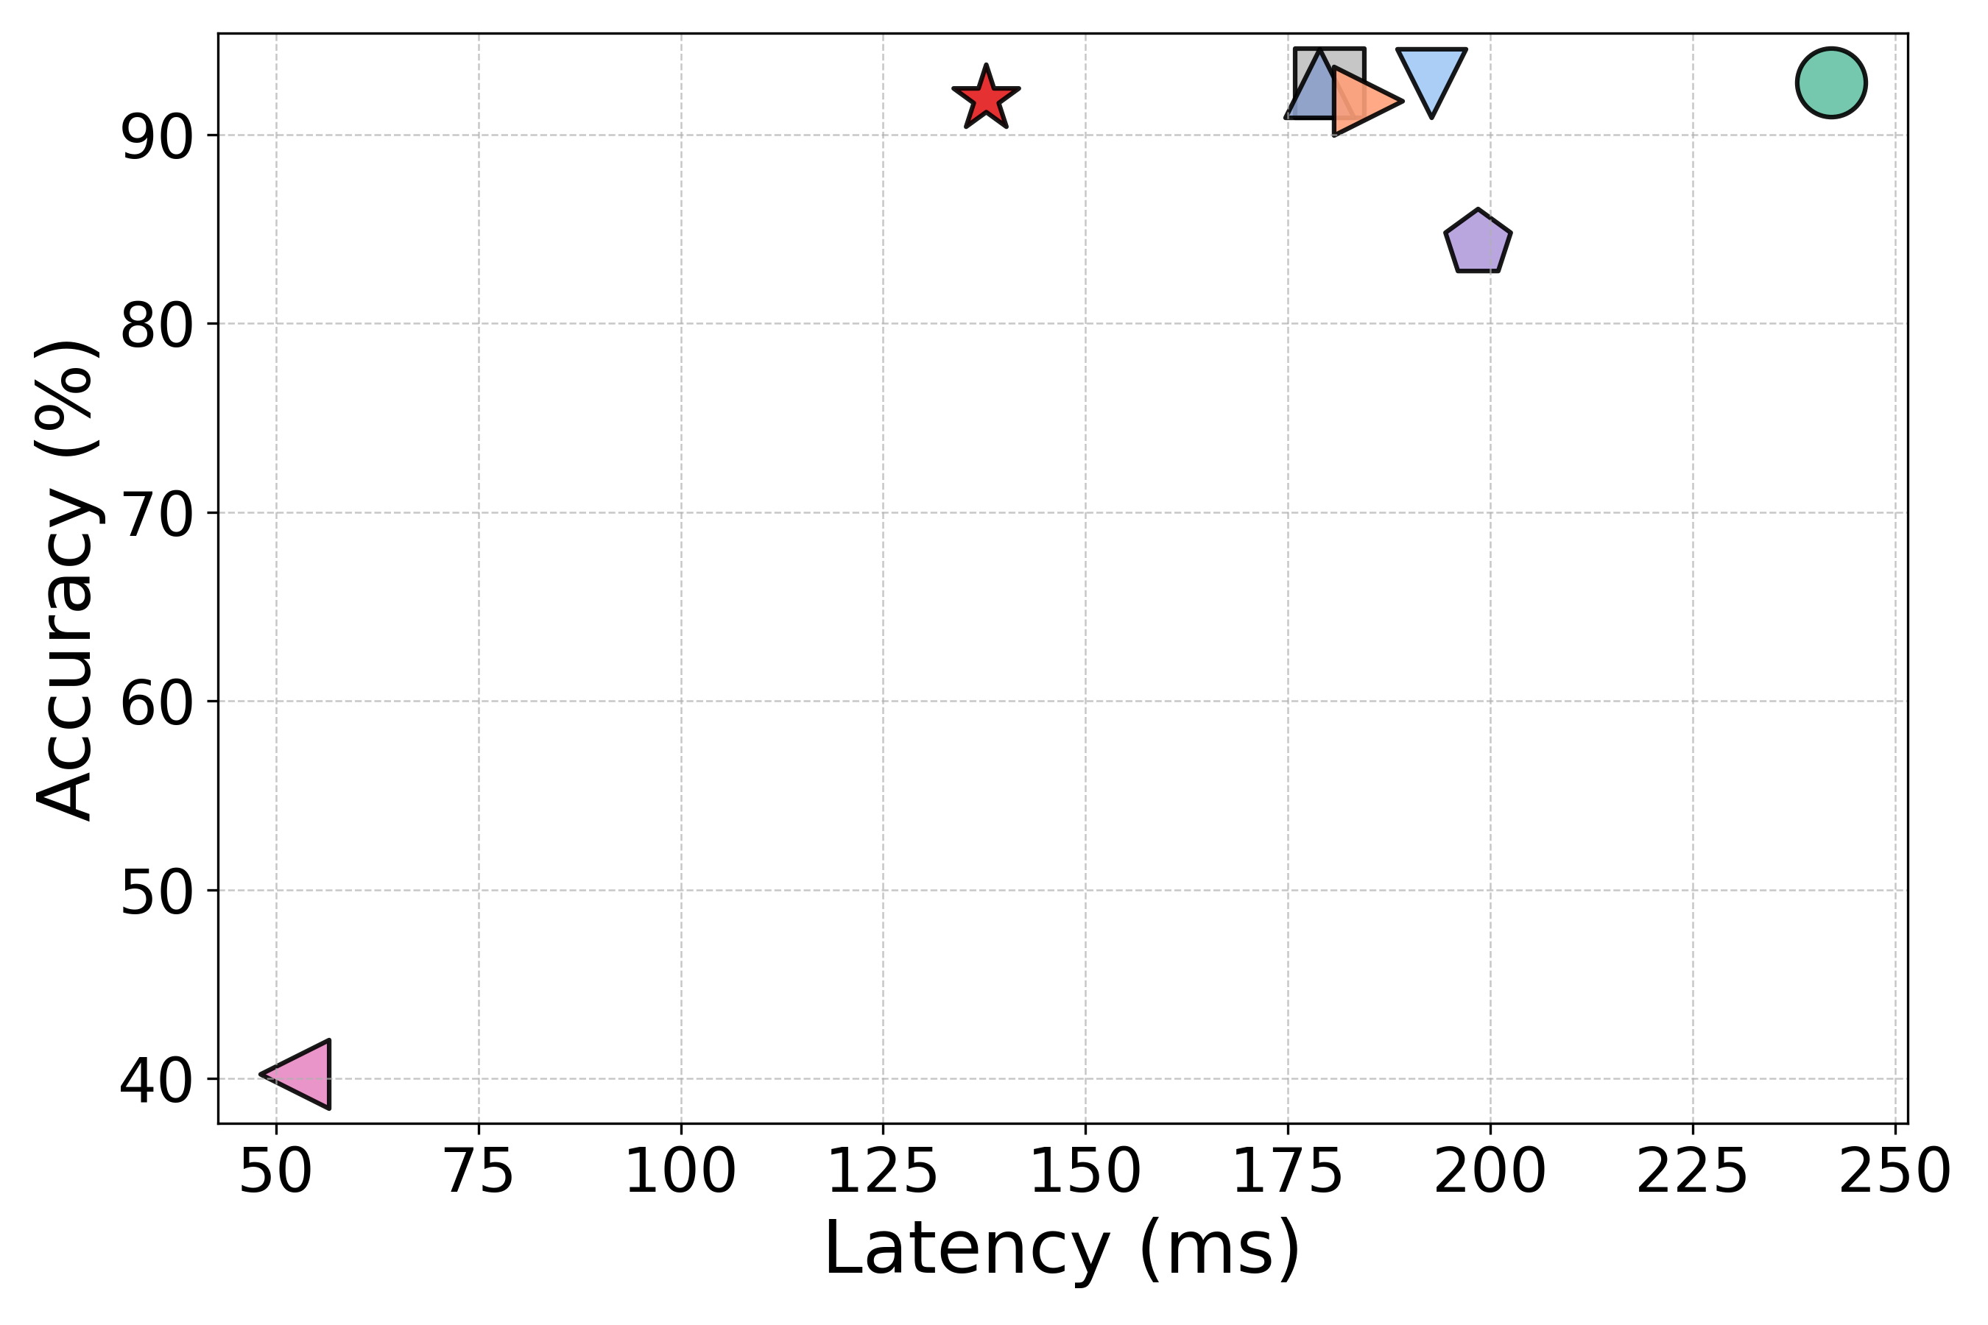
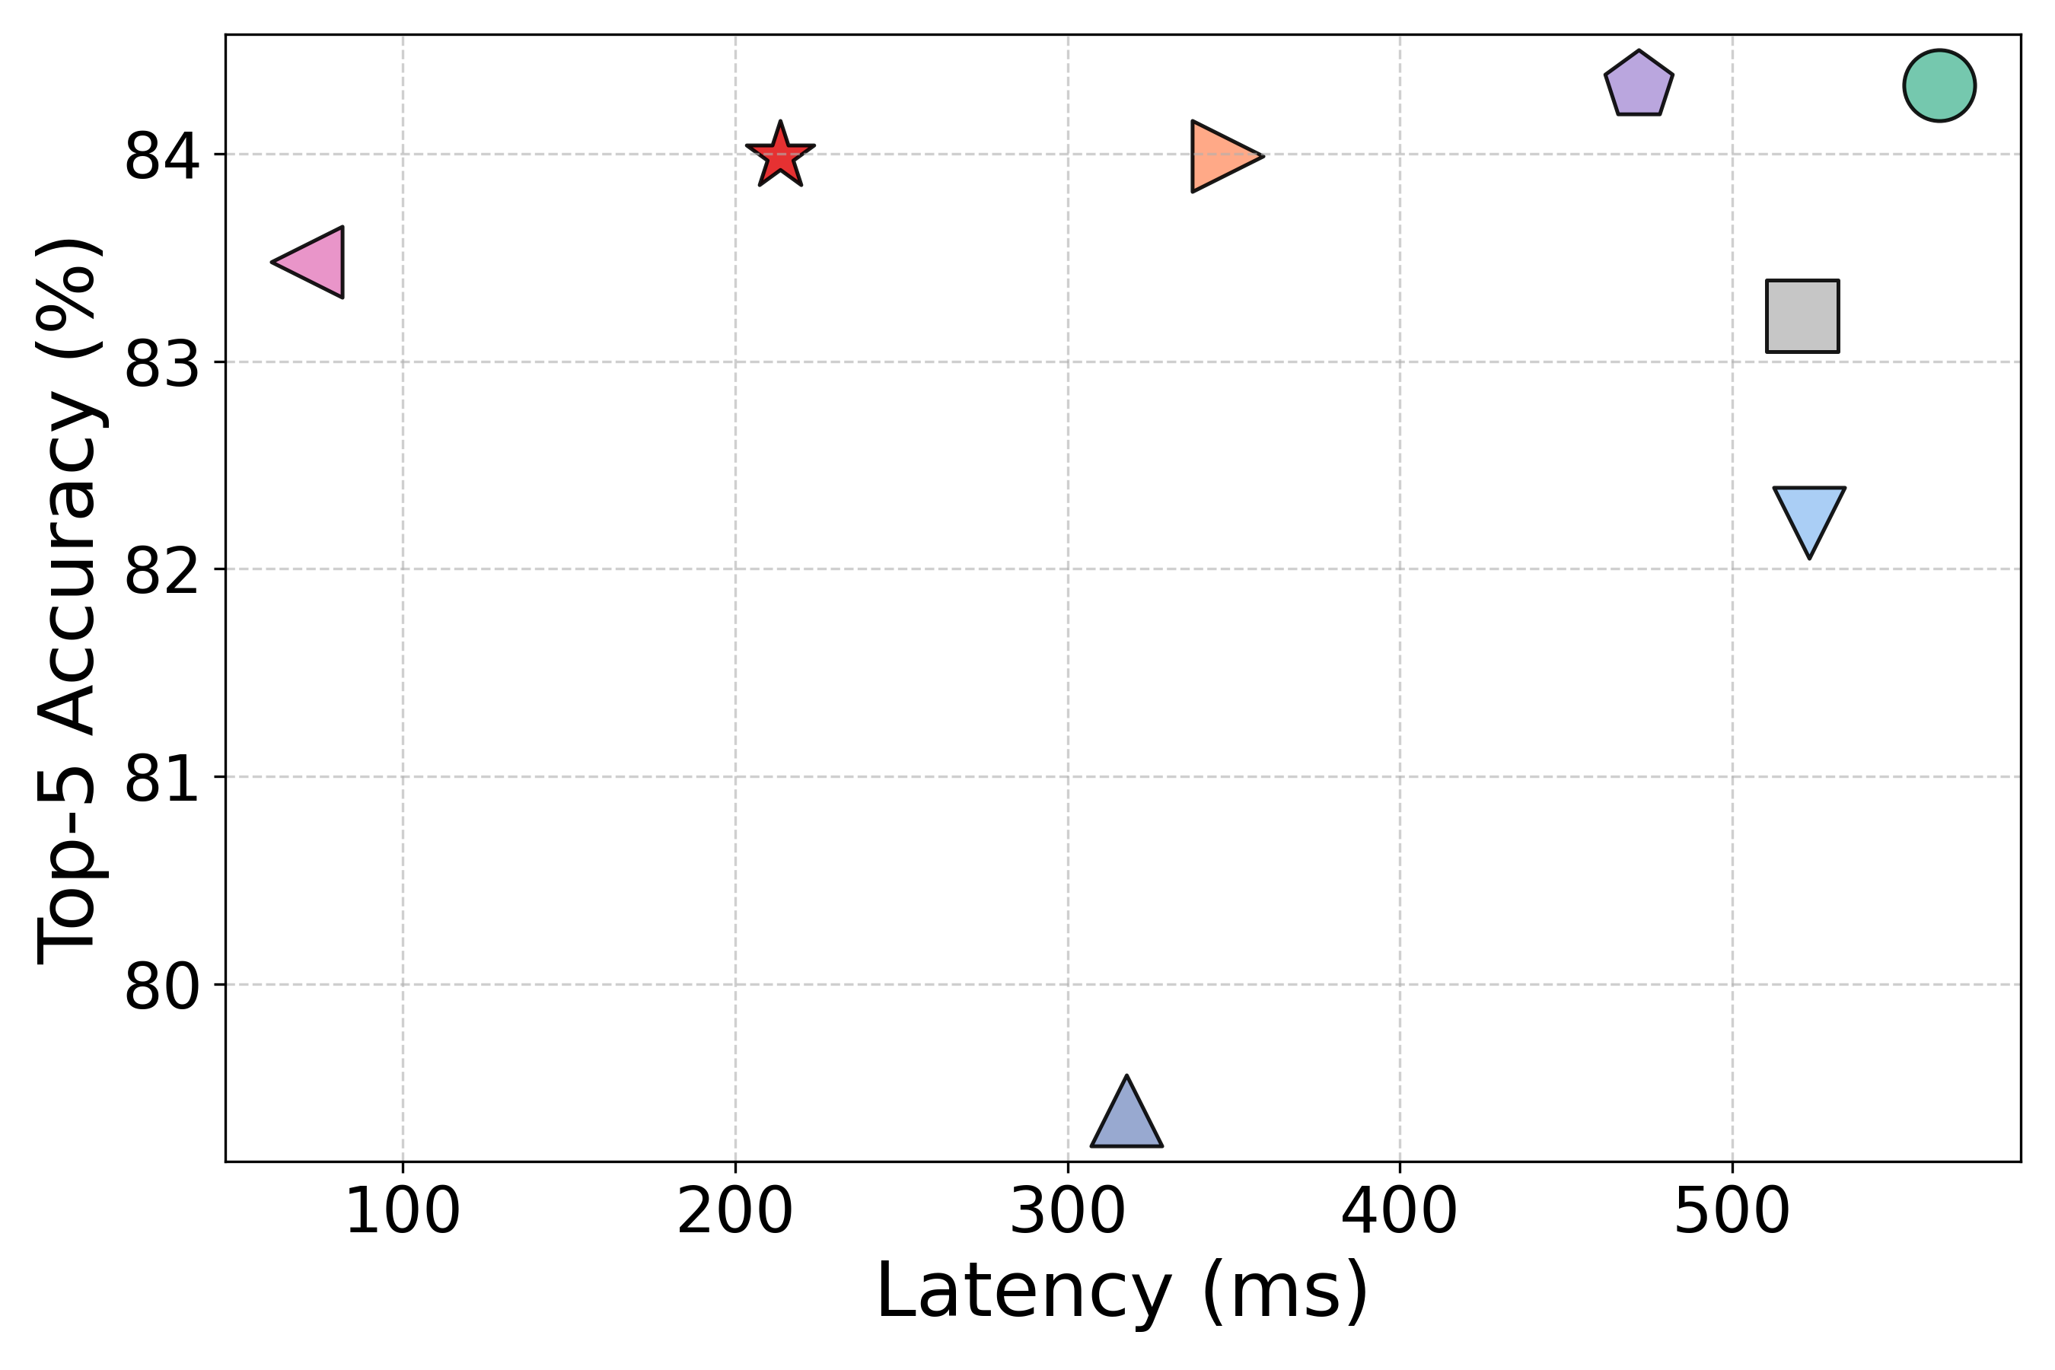
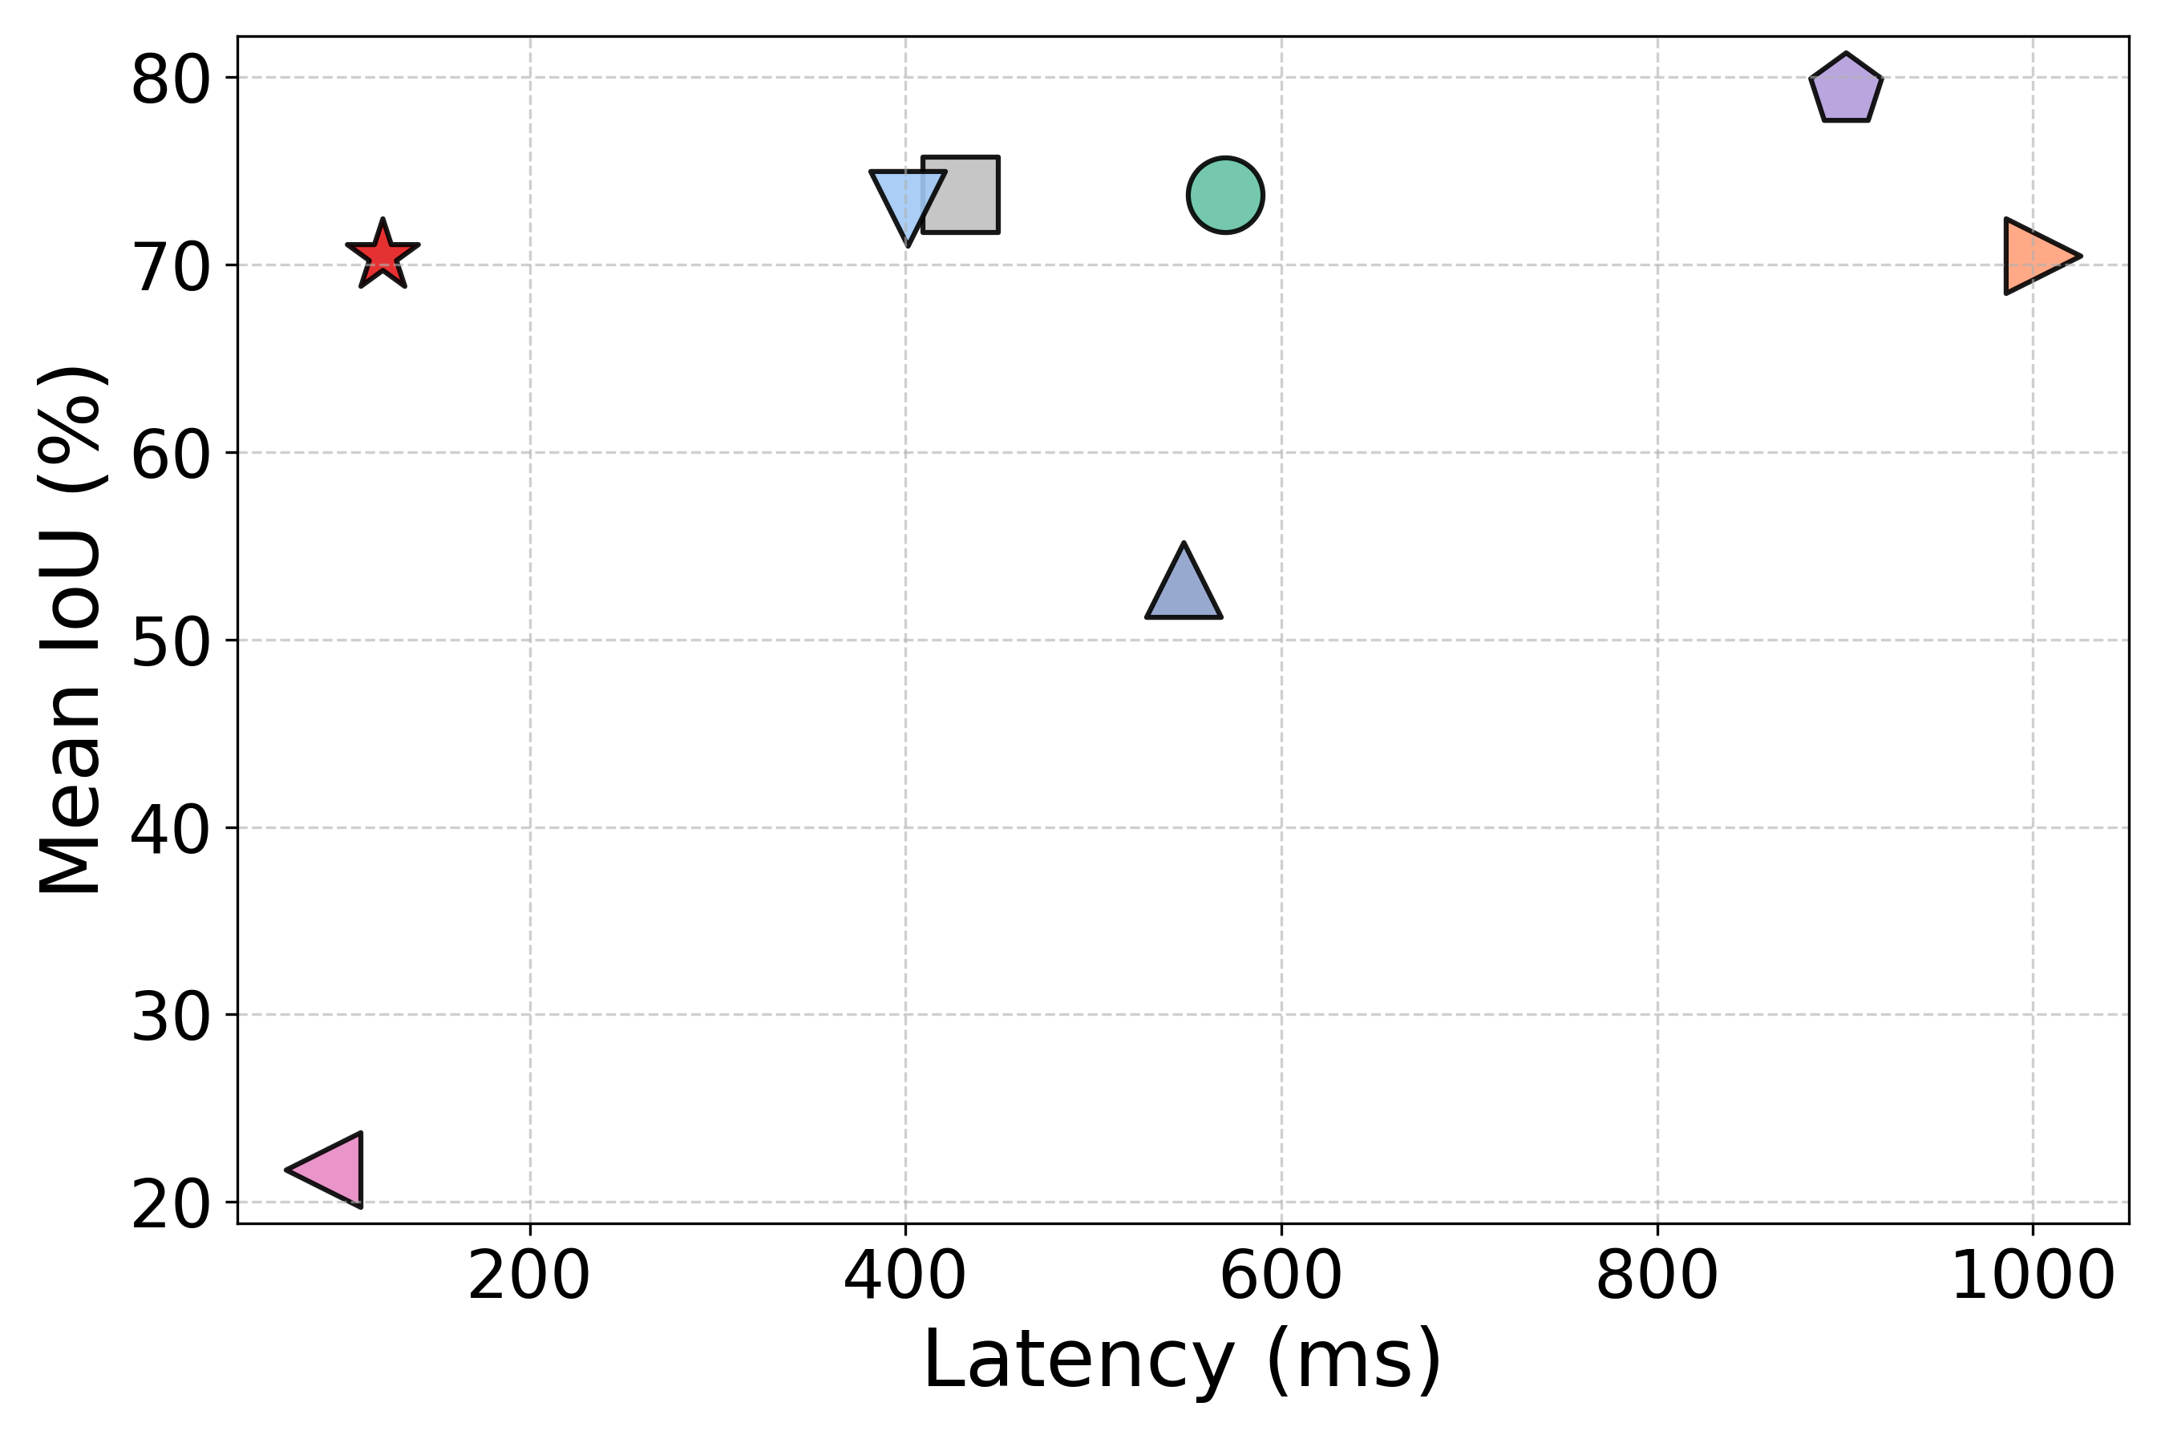




Evaluation: Overall Performance
Performance on Different Tasks
Speech Recognition
Autonoumous Driving QA
UAV-based Human Tracking
  MMEdge achieves the best trade-off between latency and accuracy

Slide 9
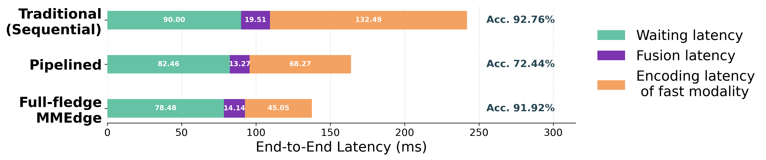
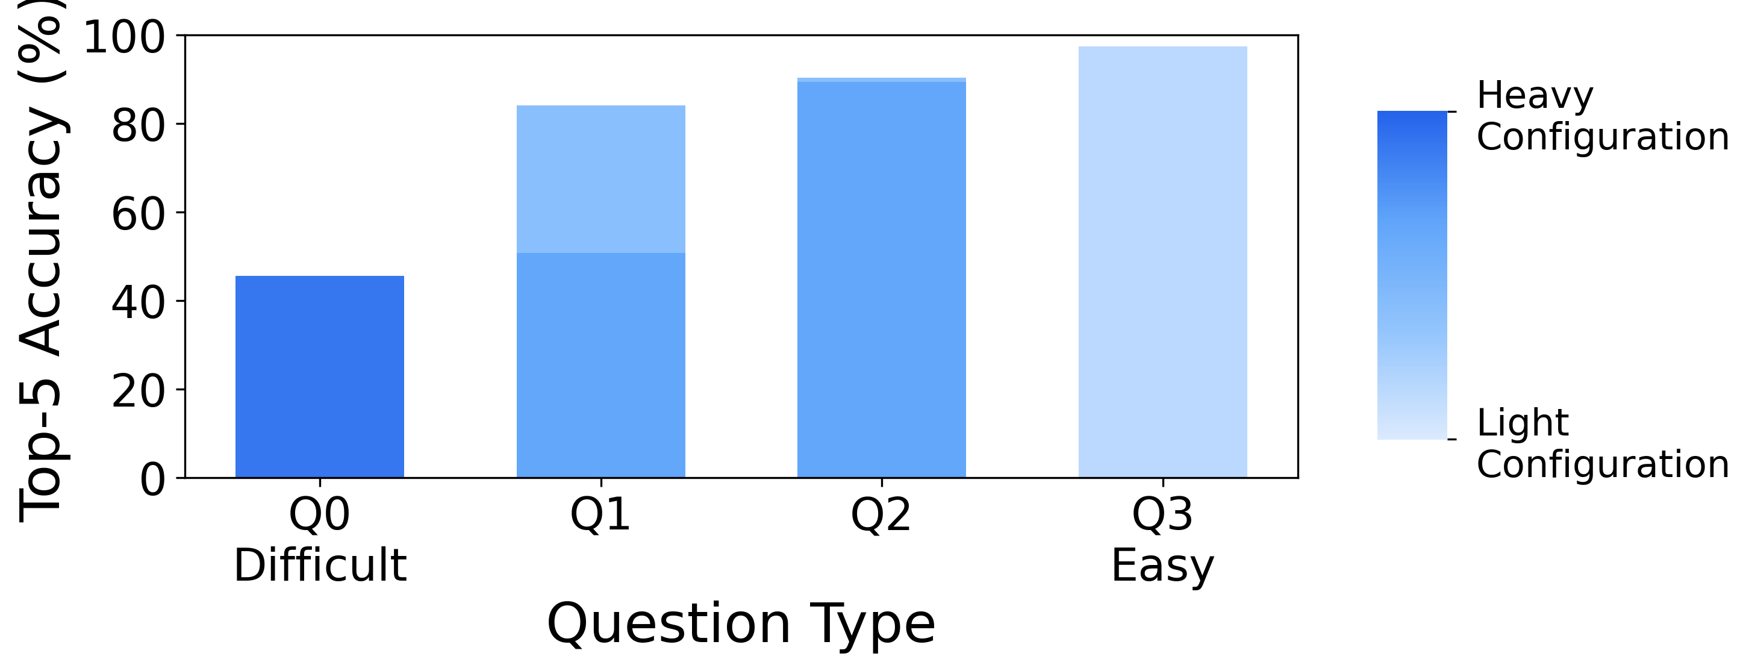
Understanding Performance of MMEdge
Effectiveness of pipelined framework
Effietiveness of adaptive multimodal configuration
Q0 (“vehicle count”) configuration: 12FPS, Resnet-50
Q3 (“existence detection”) configuration: 6FPS, Resnet-18

Slide 10
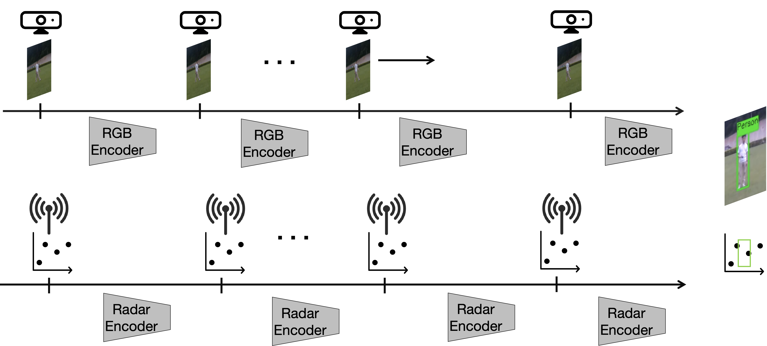
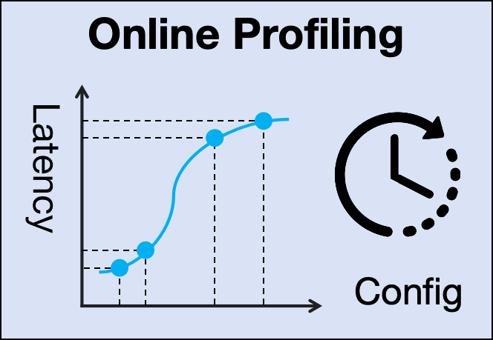
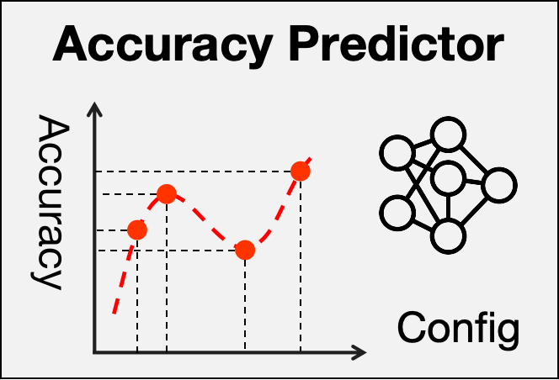
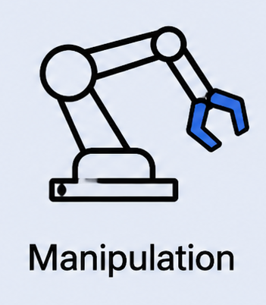
Conclusion
MMEdge: the first on-device pipelined sensing and inference framework
  Alternating-based temporal aggregation
  Adaptive multimodal configuration optimizer
Future Work:
Online profiling for rapid runtime dynamics
Generalization of learning-based modules
New applications

Slide 11



Thanks!
  Full Paper: MMEdge: Accelerating On-device Multimodal Inference via Pipelined Sensing and Encoding (Accepted by SenSys’26)
  MMEdge: Accelerating on-device Multimodal Inference via Pipelined Sensing and Encoding
  Runxi Huang, Mingxuan Yu, Mingyu Tsoi, Xiaomin Ouyang
Github Code
Demo Video
HKUST MINSys Lab

Slide 12
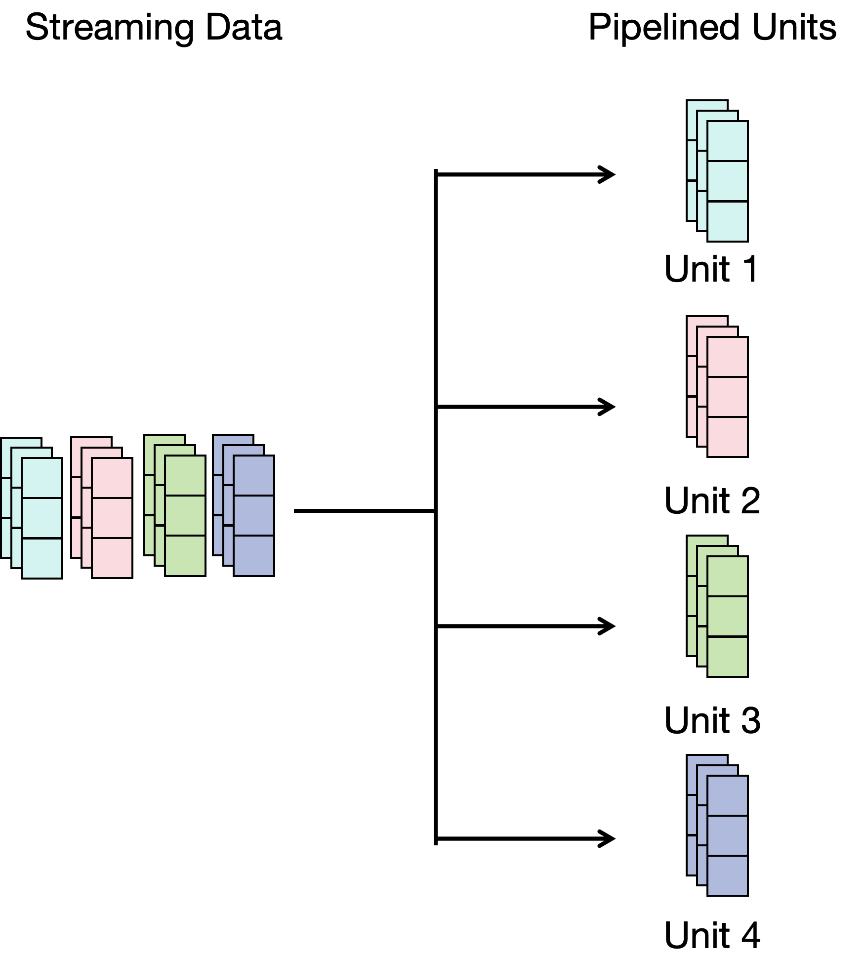
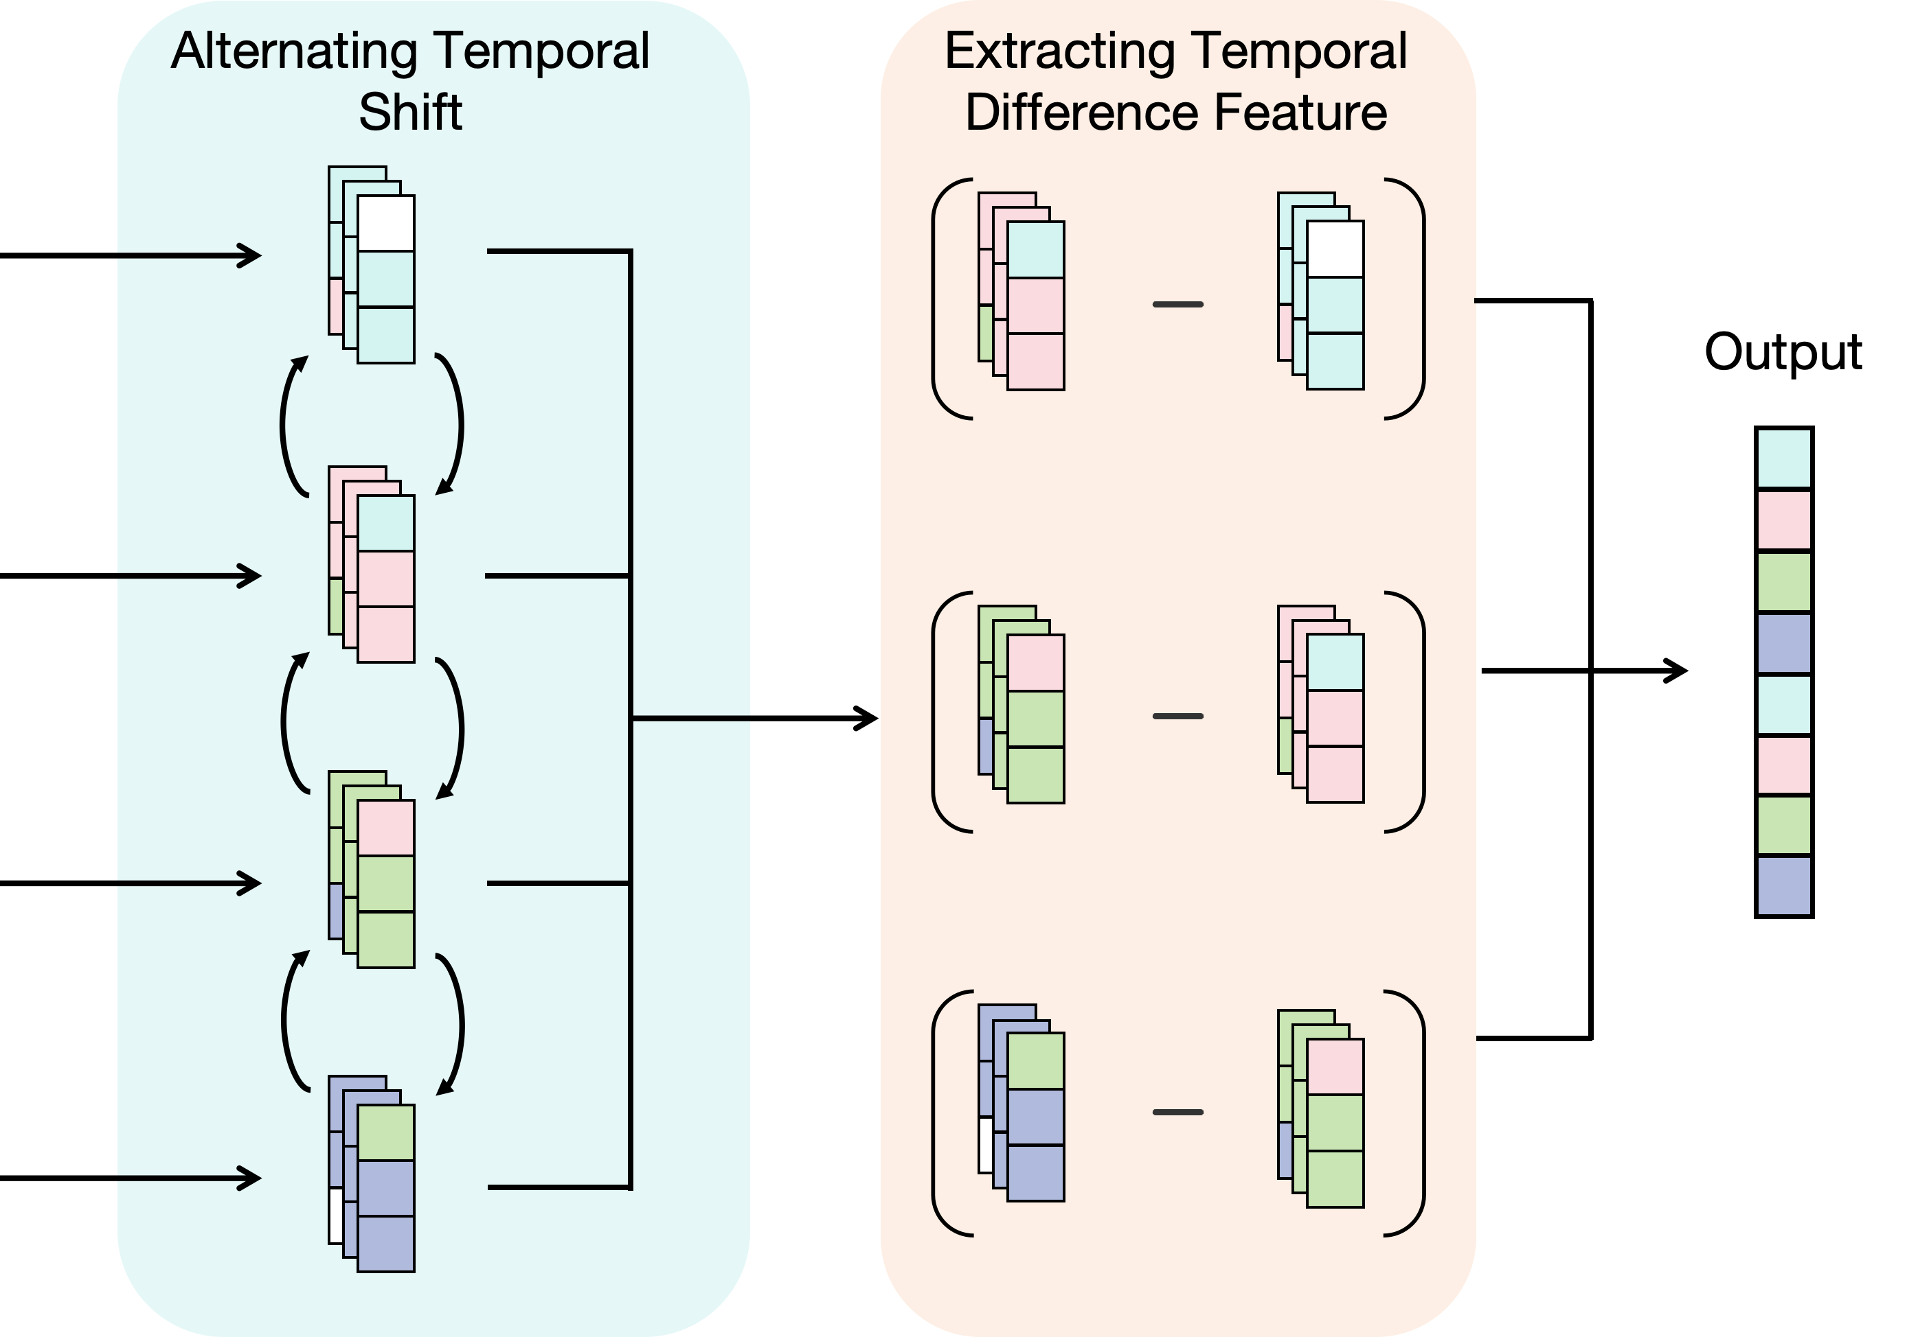
Appendix: Efficient Temporal Aggregation
Alternating temporal shift
Extracting temporal difference feature

Slide 13
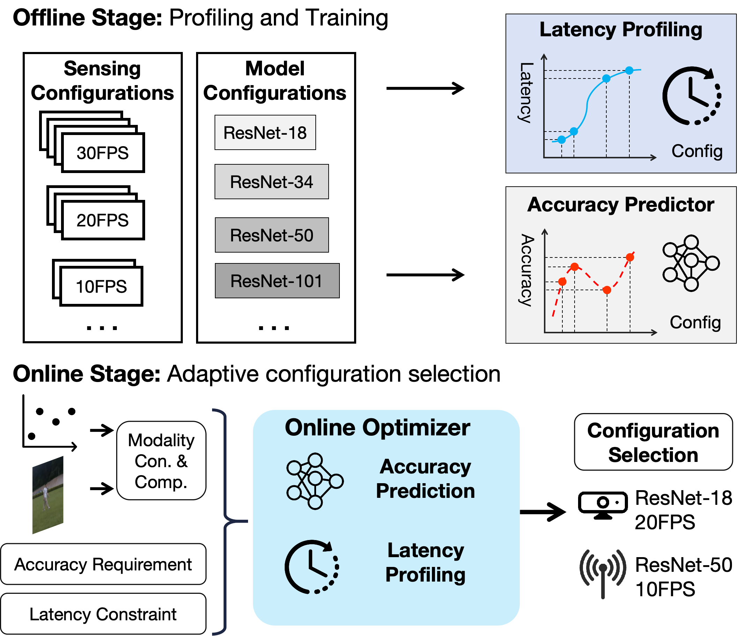
Appendix: Adaptive Multimodal Configuration
Motivation: Dynamic configuration selection under latency constraint with different decoding latency
Design of multimodal configuration optimizer
  Offline Stage
    Training accuracy predictor
    Profiling decoding latency
  Online Stage
    Data input + Resource availability

Slide 14
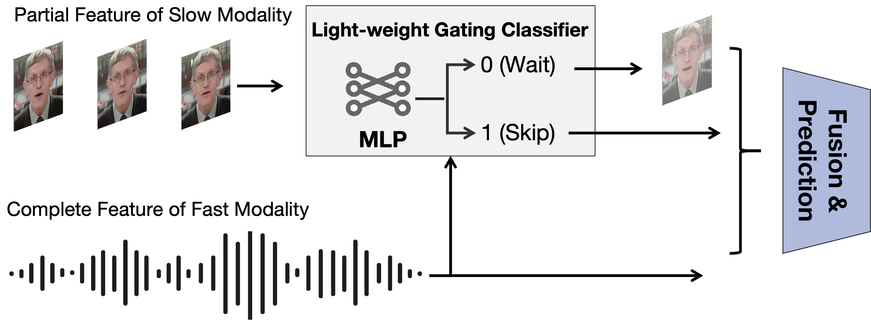
Appendix: Cross-modal Speculative Skipping
Train a light-weight gating classifier
Prediction with partial data from slower modality and full data from faster modality
Skip when prediction is confident

Slide 15
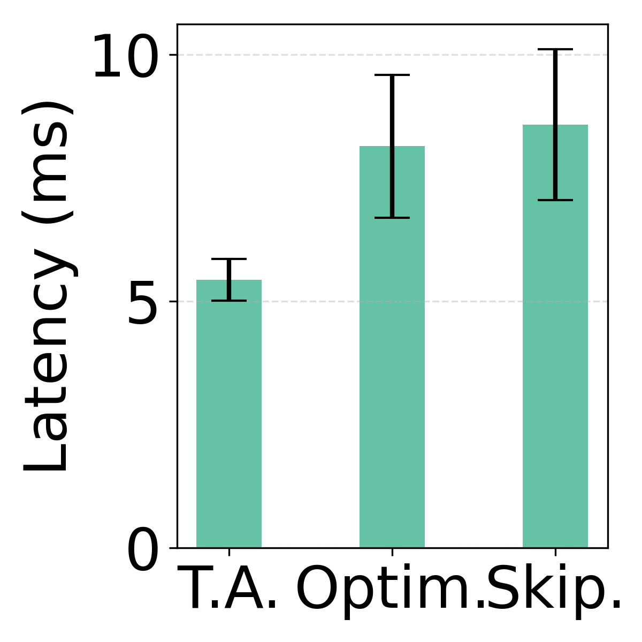
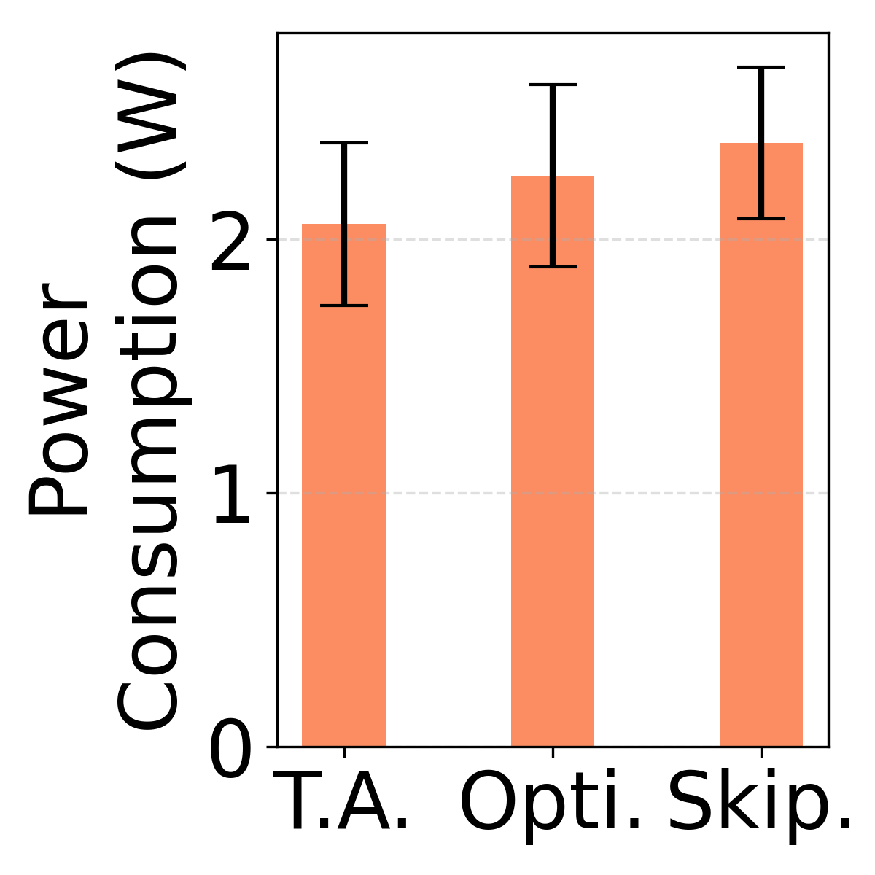
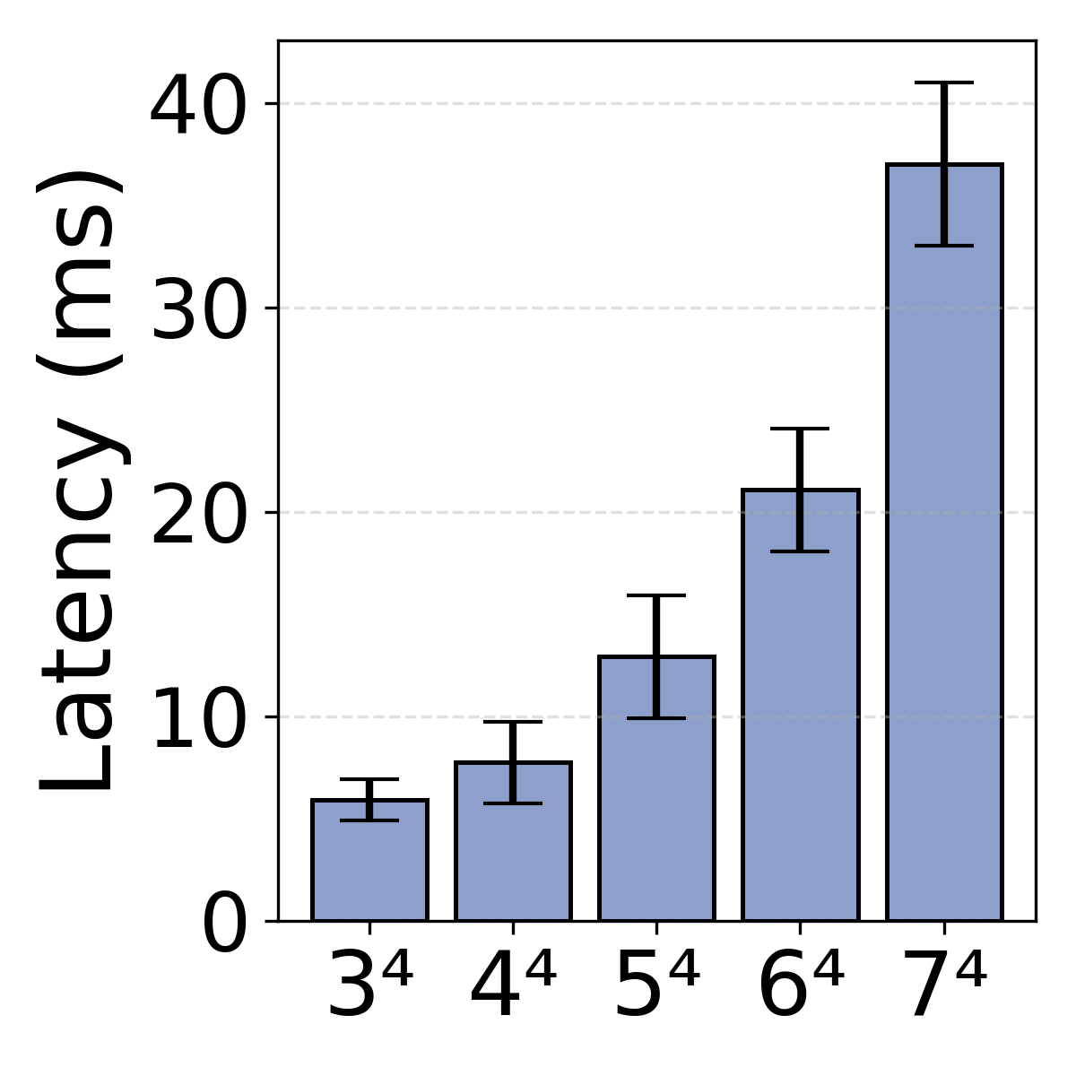
Appendix: Overhead Evaluation
All designed module with little overhead

